Slide 1
Interview Preparation for Software Engineering
By Labib Rashid / 08 May, 2020

Slide 2

About Me & Overview
Labib Md Rashid
CS Major, NSU (2019)
Google Taiwan, Feb 2020 - Present

Slide 3
Preparing for Top Tier Companies
My Interview Experience with Shopee / Garena / Sea Group by Mohammad Samiul Islam
Get a hang of your algorithms and data structure.
A good grasp of OS, Database, Networking, System design helps.
Code well in at least 1 language. You don’t have to know 10 of them.
LeetCode - The World's Leading Online Programming Learning Platform - PRACTICE
InterviewBit: Coding Interview Questions - Try some mock interviews.

Slide 4
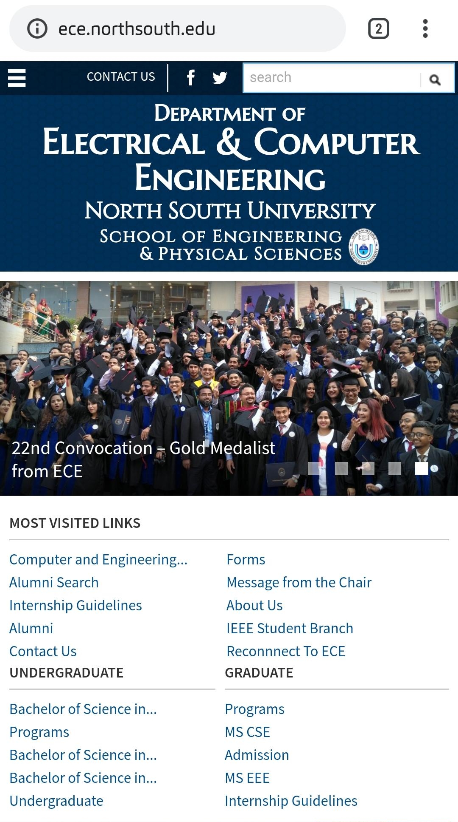
Where to Focus on Undergraduate Studies
Does CGPA matter? Don’t dropouts get good jobs?
How much does DS, Algorithm matter?
What other CS topics matter? Does research help?
Do I need a lot of projects? What kind of project do I make?
Why do soft skills matter? Why do we need to study humanities?
When do I start preparing for interviews? Do freshers have any chance?

Slide 5
Choose the right workspace!
Don’t rush into the first offer you get. Wait for the right fit.
Company size matters! Small company means more mentorship, more responsibility.
You must study your market. Don’t go for salaries too low.
Look at the perks too. Leaves, flexibility, meals, bonus, transport - these things matter.
Equity -> For companies abroad.

Slide 6
Offers and Negotiation
Do your market study. (Glassdoor , linkedIn)
Talk to friends / acquaintances in the company.
If they are lowballing you, state your minimum requirements and why you want it. Don’t back down, but be polite in your negotiation.
Competing Offers really help drive your argument home.

Slide 7
How CP and NSUPS helps
GREAT exposure to DS and algorithms.
Make CS fundamentals easy for you.
You find a great network of talented people.
Introvert? Do it for the food, travel and t-shirts.

Slide 8
Common Mistakes
Know your CV: Don’t apply for random posts.
Know your CV: Don’t state things you don’t know well.
If you have a chance to get a referral, get one. IT HELPS.
Apply to and interview with multiple companies, Competing offers help.

Slide 9
Thank You

